Slide 1

From saving the rainforests to saving our planet
A personal journey …
Brian Rasnow, Ph.D.

Slide 2
Outline
Rainforest destruction and regeneration
Psychology and perceptions: abstract vs. personal
Global warming
Exponential growth
Future predictions
Discussion
Notes:
Forgive me, I’m a scientist …

Slide 3
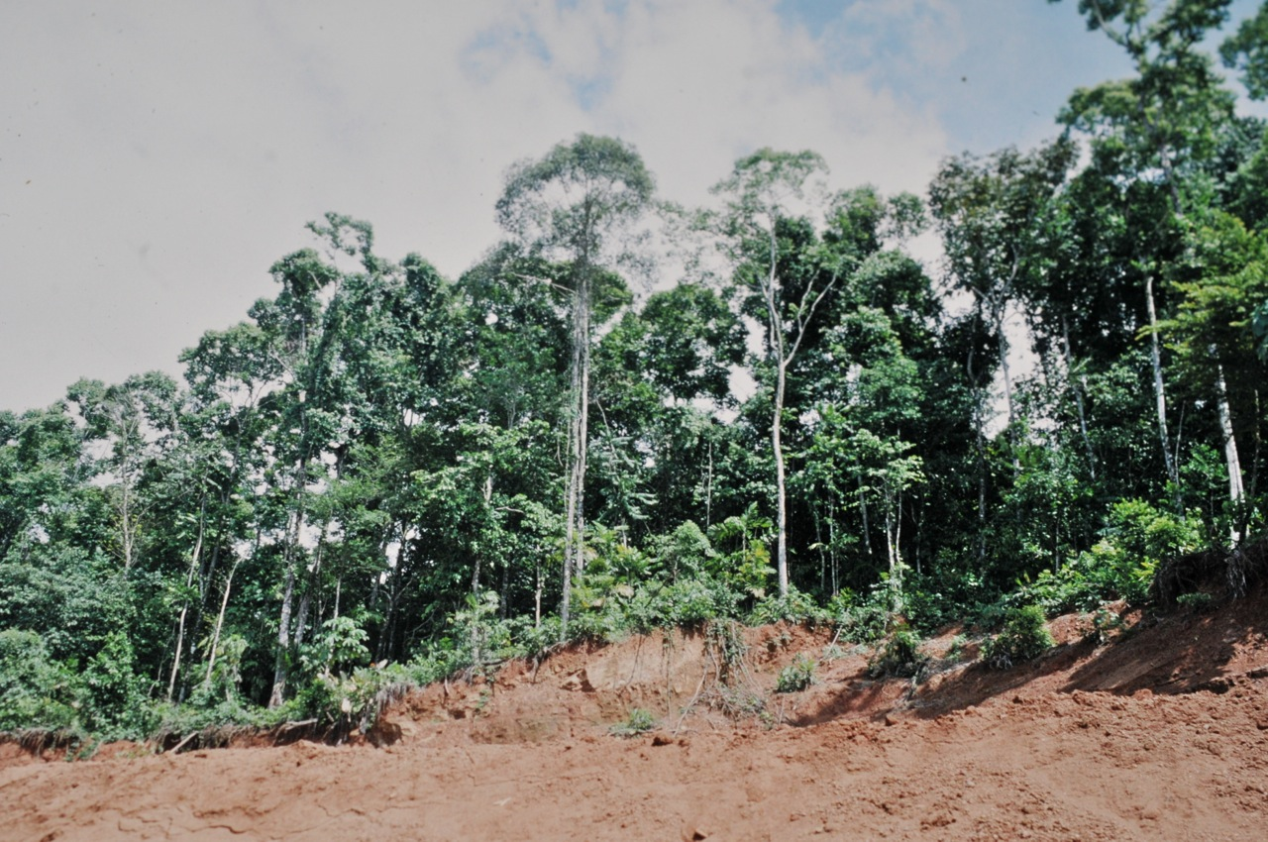
Rainforests are being destroyed

Slide 4
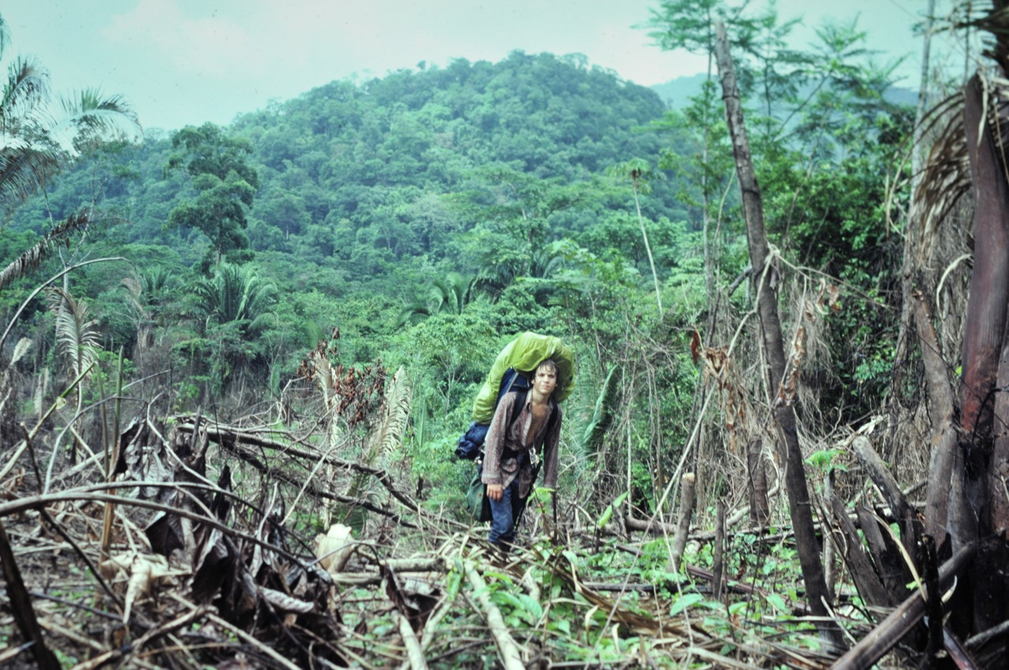
Experiencing secondary vs. primary forest

Slide 5
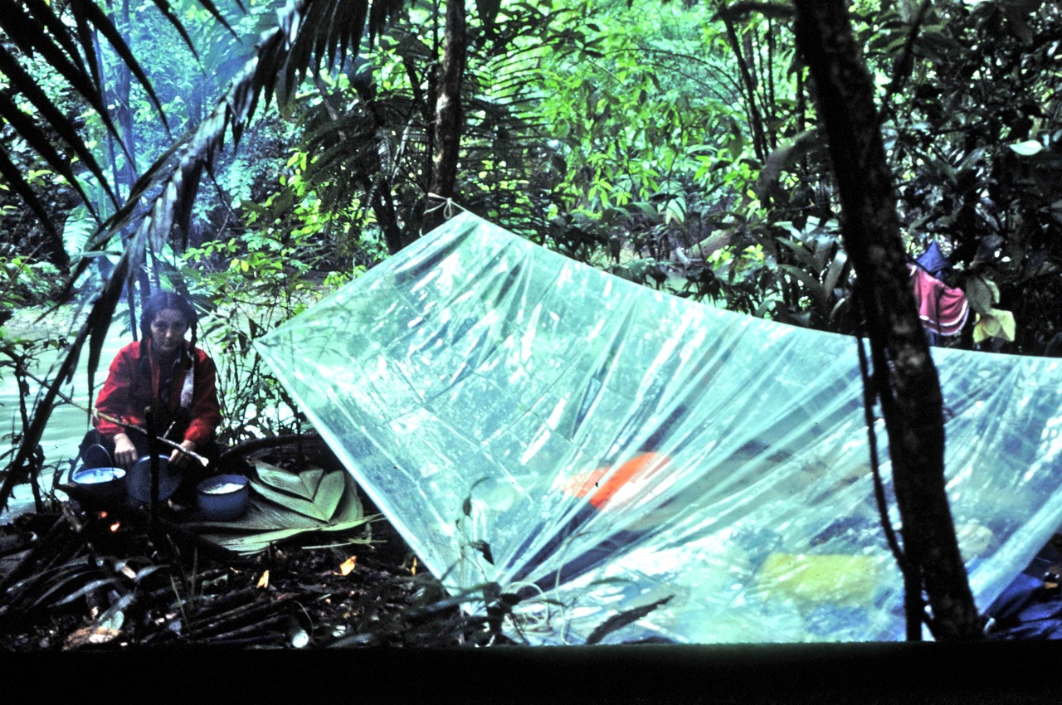
Being intimate with the forest

Slide 6

Low energy use and carbon footprint
dfga

Slide 7
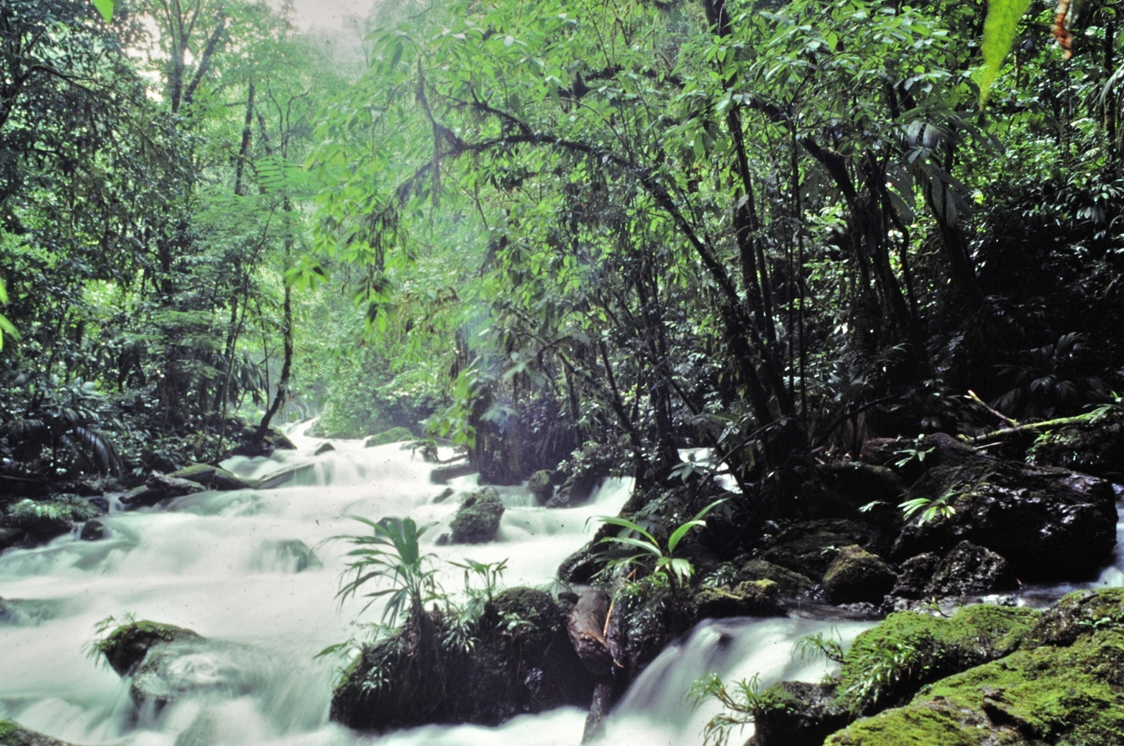
What’s the value of this?

Slide 8
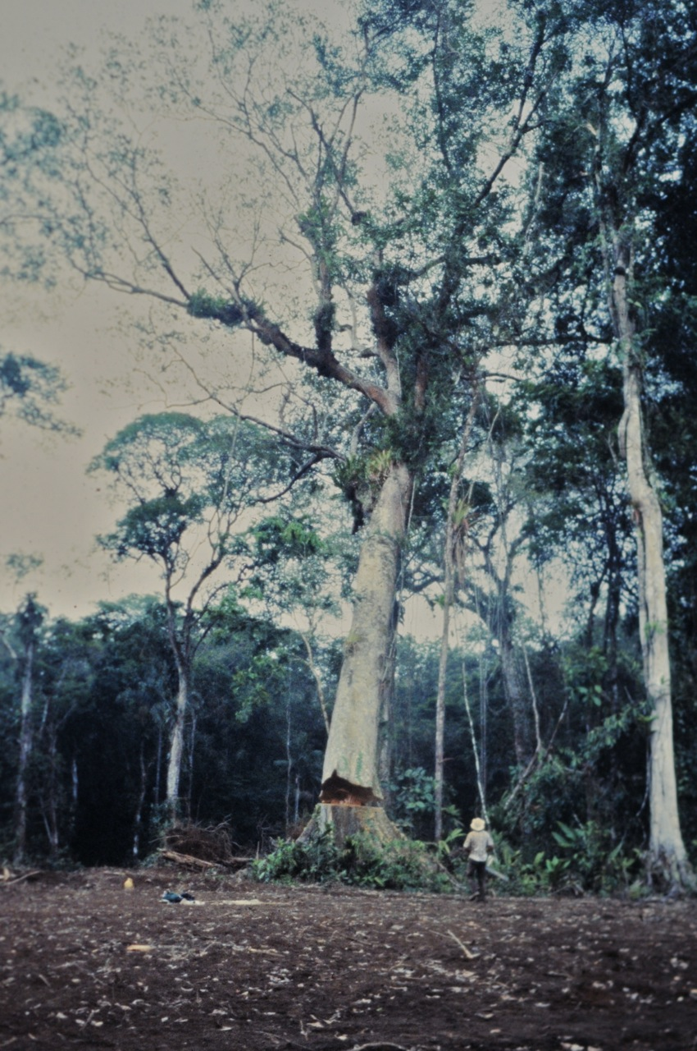
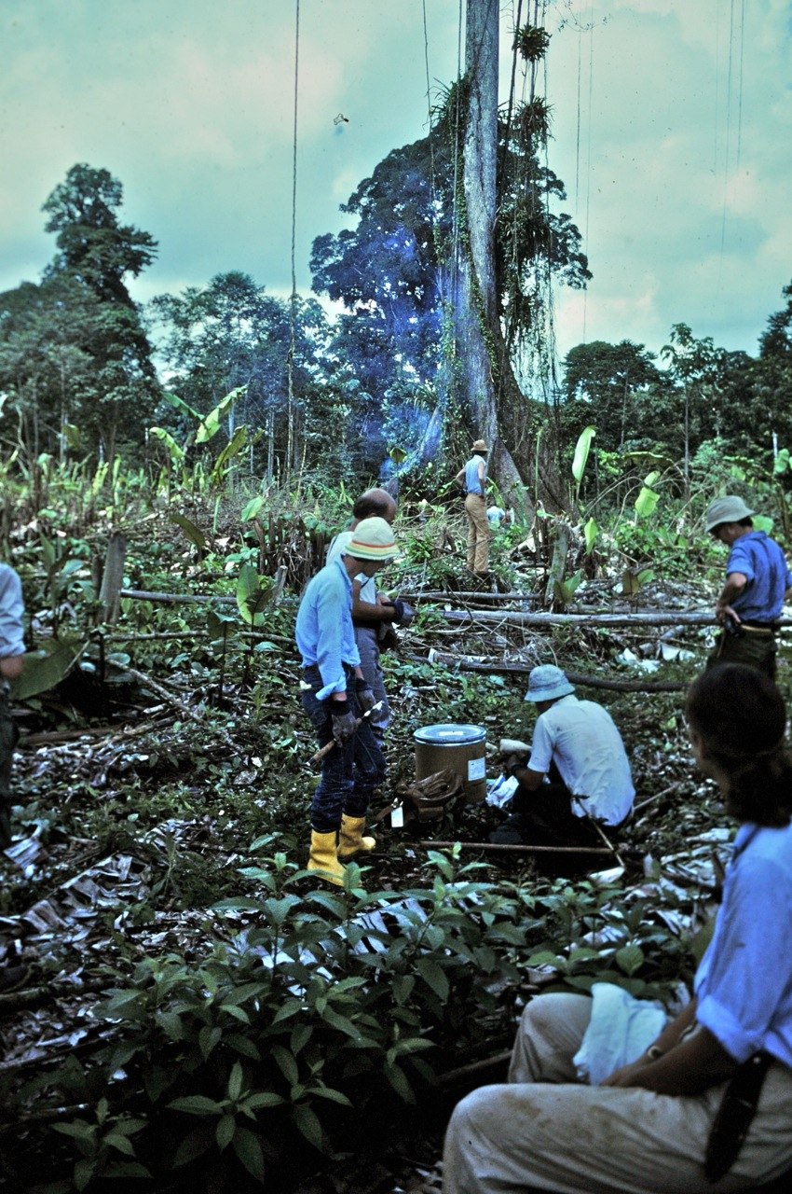
“Salvage biology”
Notes:
We saw logging clearing miles of forest each year. I joined a team of biologists and volunteers cataloging species that were going extinct before our eyes.
We’re waiting for the tree to fall, then we rush in to look for creatures that live in the canopy. We called this “salvage biology”

Slide 9
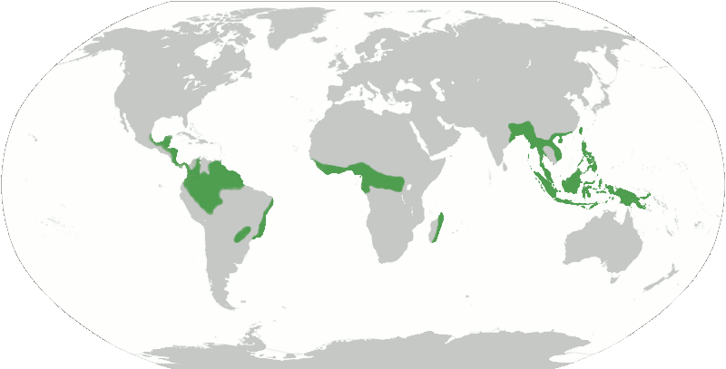
Rainforests – a global view
Rainforests cover 6% of earth yet contain ~1/2 of its species
  Its biodiversity is valuable but not valued
They covered 14% of earth ~100 years ago
Source of ~¼ of natural
medicines
28% of oxygen from CO₂
>60 uncontacted tribes in
Brazil in 2007
These are different kinds of facts
  Abstract, analytical, calculated, vs. the personal, emotional facts conveyed in the previous photos

Slide 10
Abstraction and our brains
Its much easier to be moved by personal experiences
  Rainforest destruction isn’t personal for most people
  Many people living in cities have lost touch with Nature
“Human beings are exquisitely attuned to what's happening in our immediately environment and what we can see around us and what literally touches us physically” – Anthony Leiserowitz
We don’t see the problem of global deforestation
  The causes and impacts are largely invisible
  Its faceless – unlike terrorists who we can imagine coming after us
  Most impacts will be losses (of what?) for our grandchildren
“We almost couldn't design a problem that is a worse fit with our underlying psychology”

Slide 11
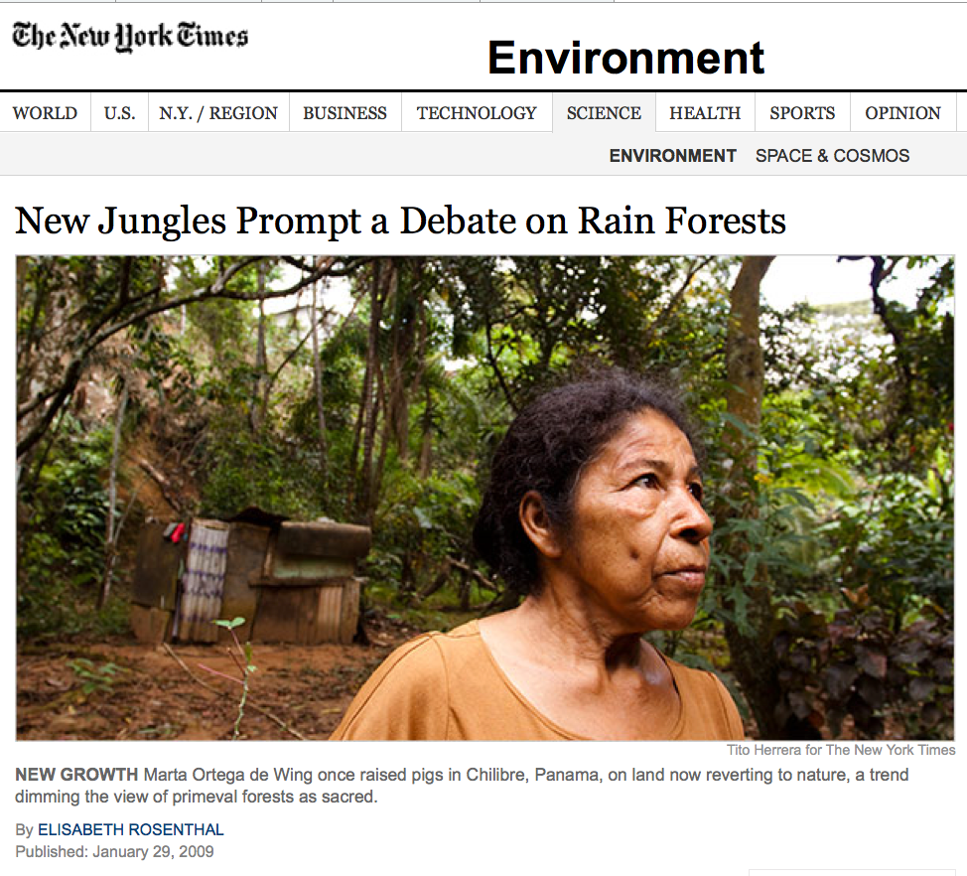
Is there a problem?
"By one estimate, for every acre of rain forest cut down each year, more than 50 acres of new forest are growing in the tropics.”
-- Jan 29, 2009 NY Times
Indigenous people have been devastated by our culture, is this another example of exploitation?
Notes:
Who’s estimate? They don’t say.

Slide 12
What’s the “debate” about?
The debate is about the value of secondary forest
“Everyone agrees that large-scale rain-forest destruction in the Amazon or Indonesia should be limited or managed. … At issue is how to tally the costs and benefits of forests...”
Scientists will always debate – the frontier of science is inherently ambiguous and competition of diverse theories is the scientific process to build understanding

Slide 13
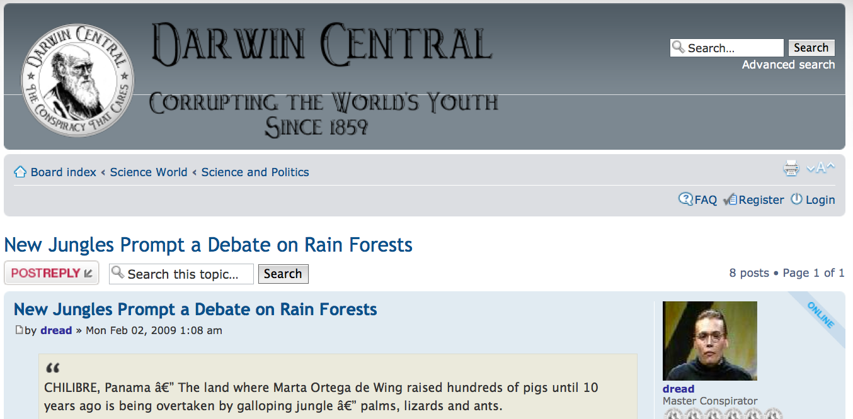
The “Debate” Travels …
Many reactionary websites pick up and embellish this story
  E.g., “In other words, government is a broker in pillage, and every election is sort of an advance auction sale of stolen goods.”

Slide 14
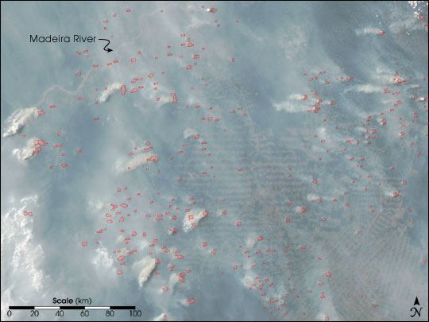
Deforestation is a problem
In 1986 NASA scientist James Hansen released satellite photos showing thousands of fires burning simultaneously in the Amazon
This broad picture seems indisputable: mankind has destroyed over half of Earth’s rainforest in ~100 years and is on a trajectory to finish them off in the next few decades
  The details aren’t clear: E.g., secondary growth, national parks, tourism, will preserve patches of various habitats that will sustain a subset of existing biodiversity …
  Are we OK with the broad picture?
    Who benefits and suffers? Now vs. later?
    What are we willing & able to do to change it?

Slide 15
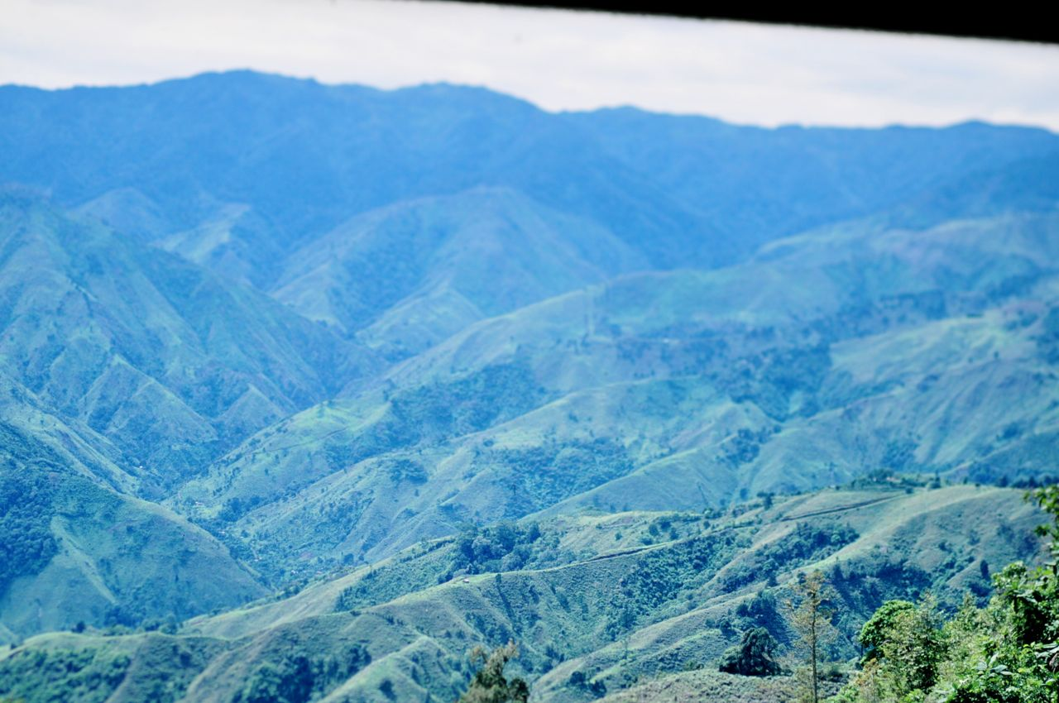
A view from the ground …

Slide 16
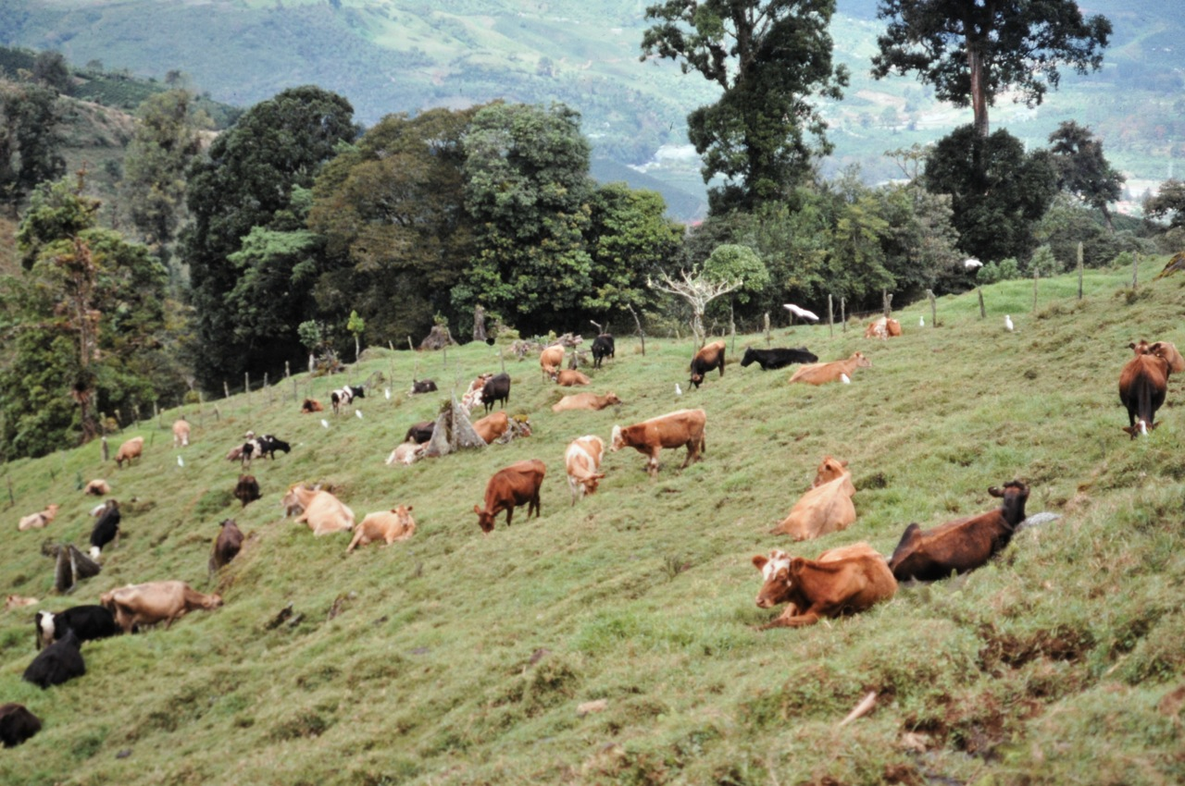
We took over a tired, eroded farm …

Slide 17
Our typical farm in Costa Rica
Ambitious goal
  Discover a generic recipe to regenerate rainforest from eroded pastures
Scientific methods
  Empirical research, reforesting with mixtures of native species identified by taking an inventory
Results
  ~150 tree species identified, 34 species of commercial timber
  Government found our plan too risky; would only subsidize a conventional (and failing) reforestation plan

Slide 18
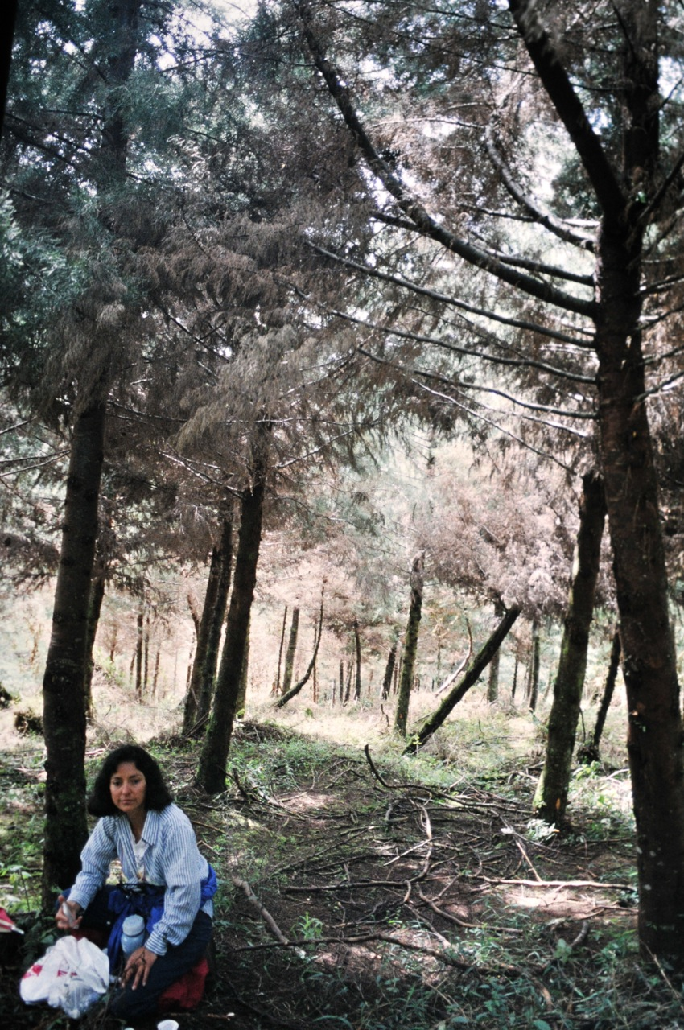
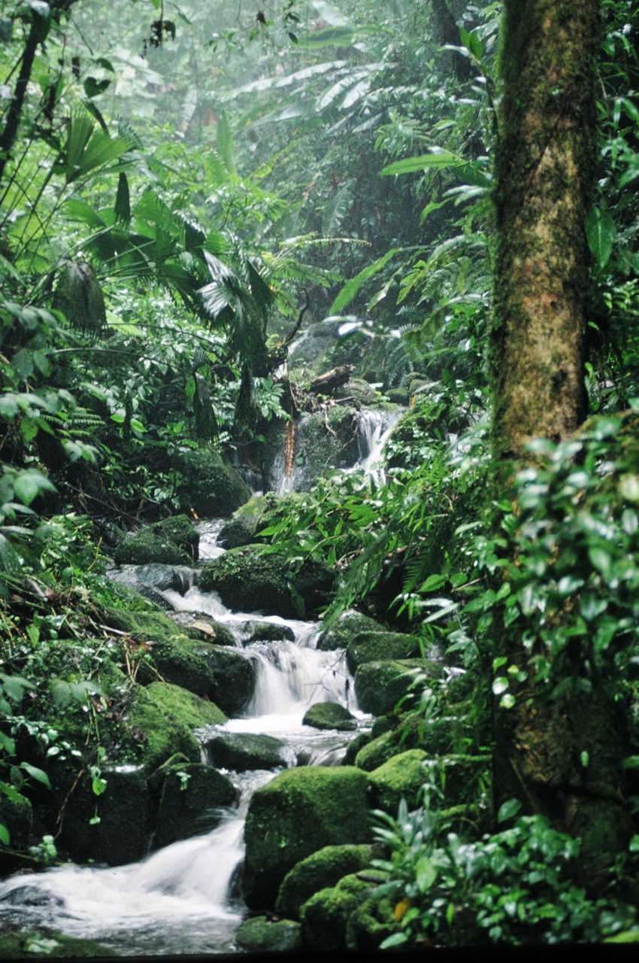
Re – forestation?

Slide 19
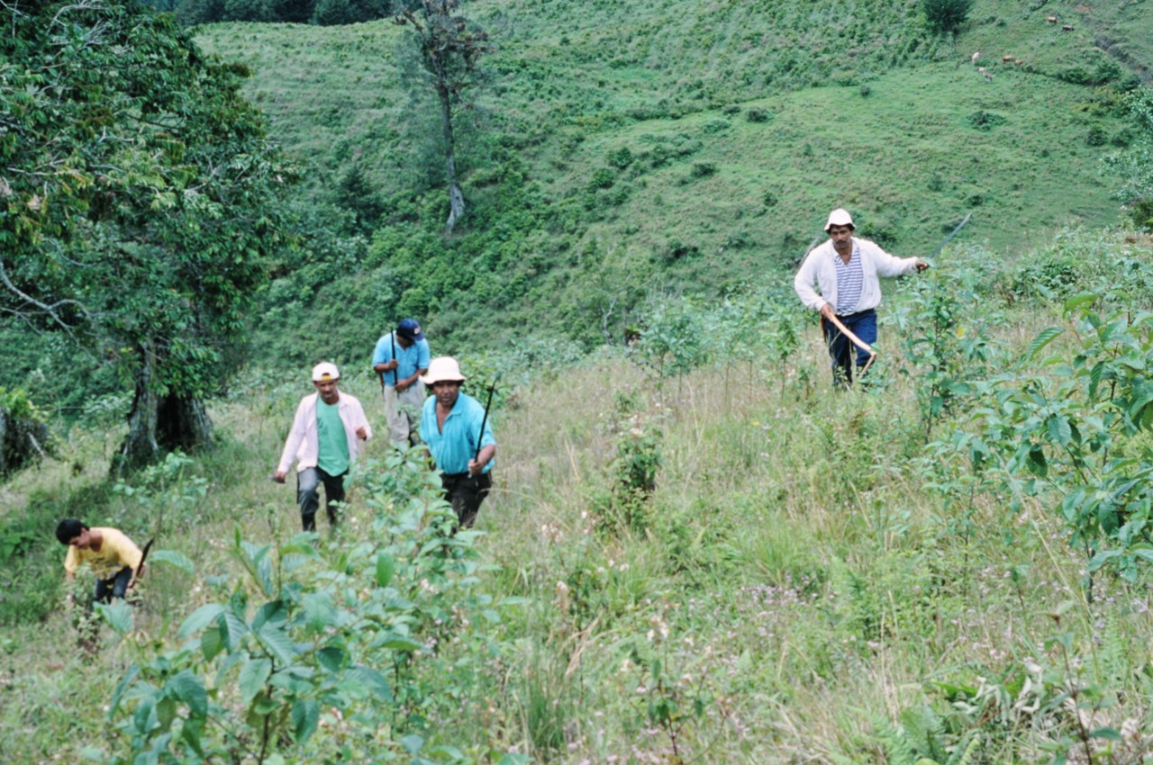

Slide 20
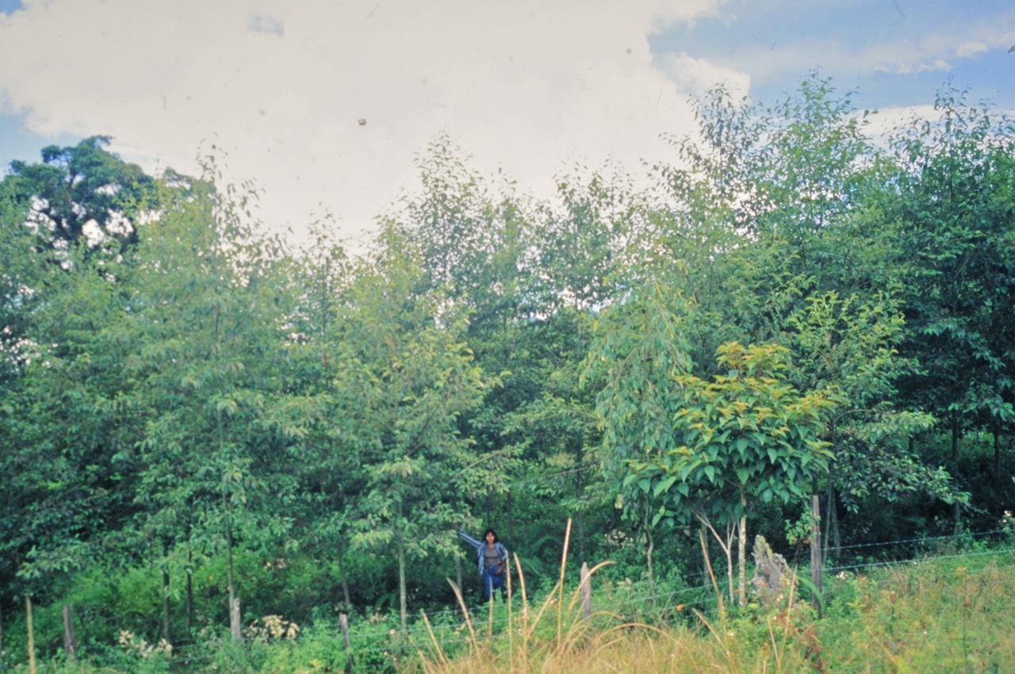

Slide 21
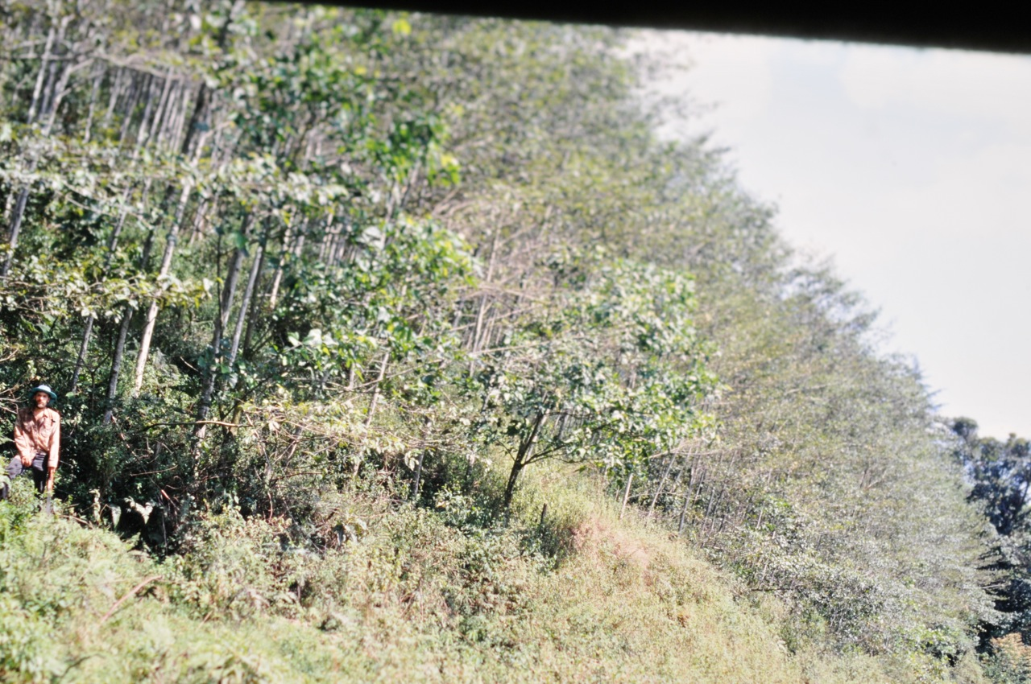

Slide 22

Conclusions
A recipe to recover rainforest from eroded pastures is:
  Leave the land alone
  Keep cattle (and people) off it
Meta-conclusion: Best case scenario analysis
    If I found magic pixie dust to instantly turn eroded cow pastures into rainforest, then what?
    Is the best case scenario good enough?
    A tall fence won’t protect against global warming …

Slide 23
Global Warming
Global warming will likely decimate rainforests
  Rapid climate change stresses ecosystems
  Many forests are stressed from local climate change
Refugees from droughts, floods, rising sea level, may lead to political chaos and pressure on nature reserves
Is global warming real?
Is it stoppable?
Notes:
The biggest danger of GW isn’t that we burst into flames, but that it leads to social chaos, wars, genocides. This is likely what befell the Maya, Anastasi, and other earlier societies.

Slide 24
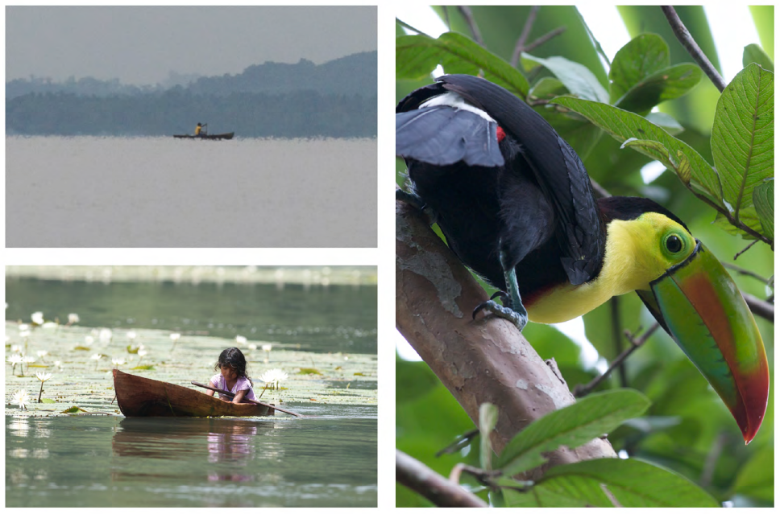

Slide 25
Global Warming
Global climate is conceptually simple and mind-boggling complex
  Physics gives us a powerful understanding of energy transport, which drives climate (and life)
  Complex models have inherent uncertainties
  Scientists (biologists, chemists, physicists, paleontologists, etc.) have done an incredible job piecing together key facts from the laboratory, field, computer models, and theory
    “Your theory shouldn’t try to explain all the data, because not all the data is correct” – Richard Feynman

Slide 26

How to accurately measure
Earth’s temperature?
Now and a long time ago? And what makes it change?

Slide 27

Ice cores

Slide 28
Ice cores
Global warming isn’t a conclusion made by amateurs running around with thermometers
A fundamental difficulty is measuring (and extrapolating) tiny trends before the changes become too big or costly to manage or stop
  Fractions of a degree when daily variations are ~20°, weekly and seasonal variations are much larger
  A millimeter of sea level that varies ~1 meter twice a day

Slide 29
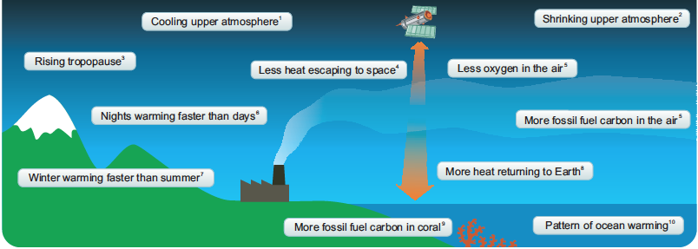
Global warming should have many signatures
All of these (and may other) signs of global warming are observed

Slide 30
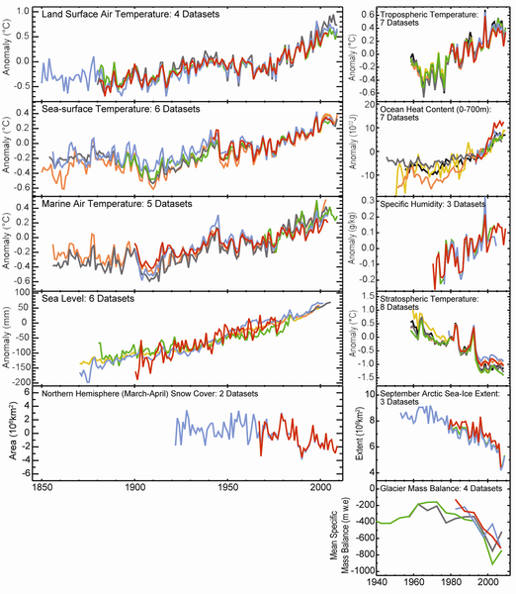
Numerous signs of GW
11 key indicators of global warming (2010)
Satellites observe less heat radiating into space
Ocean acidification
Earlier spring
Weather records
Intense storms
Plant/animal migrations
Largest trees dying
Increased sea ice
Etc.
Notes:
Some signs are a little counterintuitive

Slide 31
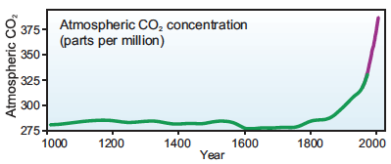
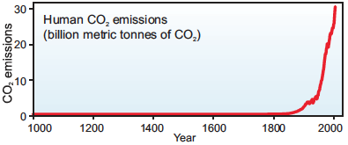
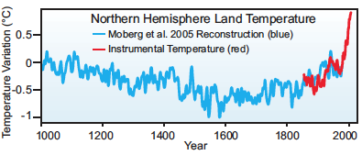
Why is Earth warming now?
Humans now burn 9 billion tons of carbon/year. The atmosphere weighs 5x10¹⁸kg → fossil fuels add 2 ppm of CO₂ per year
There is little doubt that fossil fuel burning has raised CO₂ levels to the highest it’s been in at least 2 million years
There’s little rational doubt that this will have devastating effects on the ocean and food chain
But how much of global warming is caused by CO₂?

Slide 32
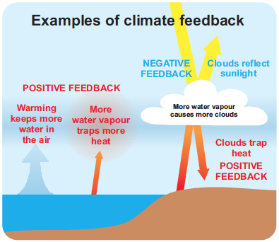
Cause vs. effect
Feedbacks make it difficult to establish what started the warming…
Historic warming epochs were driven by other forces. CO₂ increased a few hundred years after global warming, a slow positive feedback.
CO₂ has never before increased this rapidly

Slide 33
Climate Sensitivity to CO₂
How much does CO₂ warm the earth?
  Without feedbacks, doubling CO₂ would cause 1.2°C warming
  Most studies suggest 2-4.5°C with fast feedbacks
Latencies mask effects
  Melting ice is absorbing huge amounts of energy without any warming
  Deep oceans are warming slower than the surface
  Warmer water dissolves less CO₂

Slide 34
Effects of warming
7000 years of stable sea level is ending
  ~1 billion people live within 10m of sea level
Extreme weather: storms, droughts
  25 events cost USA $188 billion in 2011 (NOAA)
WHO (2009) estimated global warming was responsible for 3% of diarrhoea, 3% of malaria, and 3.8% of dengue fever deaths worldwide in 2004
Many effects are irreversible, at least over time scales of many human generations
Notes:
Maybe dubious numbers – but disconcerting …

Slide 35

Distractions instead of solutions …
“Climategate” – out-of-context quotes from hacked emails → every independent investigation exonerated the scientists
CERN study
Eight independent committees investigated these allegations, found no evidence of fraud or scientific misconduct
  UK House of Commons; US Inspector General; NSF; EPA; etc.

Slide 36
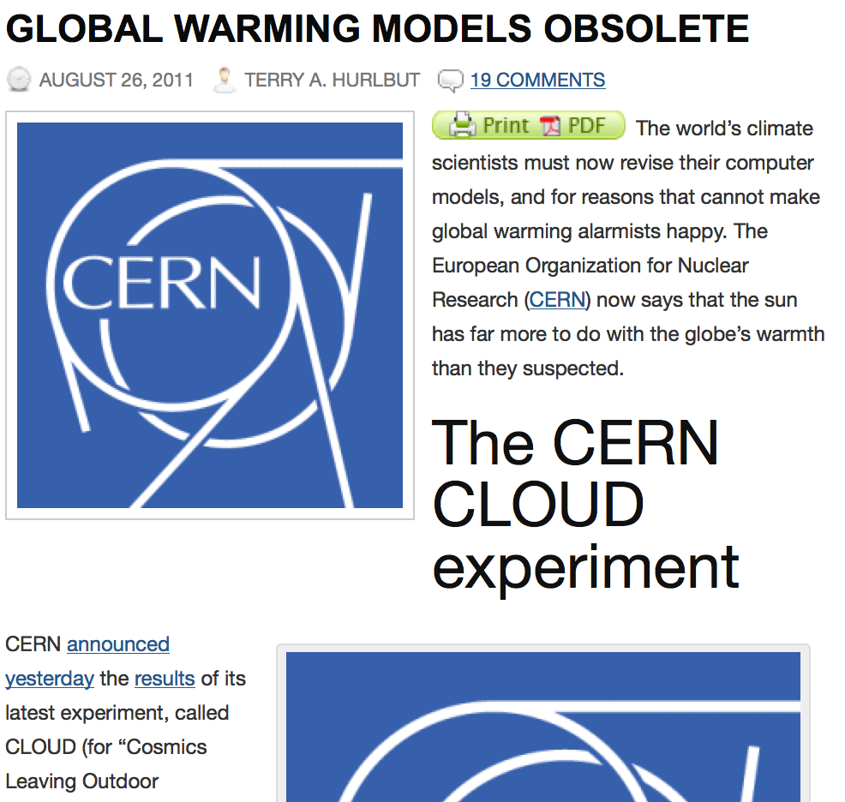
Distractions instead of solutions …
Research suggests a possible mechanism for cosmic rays to affect climate
  Weak effect
  Doesn’t correlate with global temperature nor (attempt to) explain much of the vast data from the oceans and climate
  Its author denies the conclusions attributed in the fringe press

Slide 37
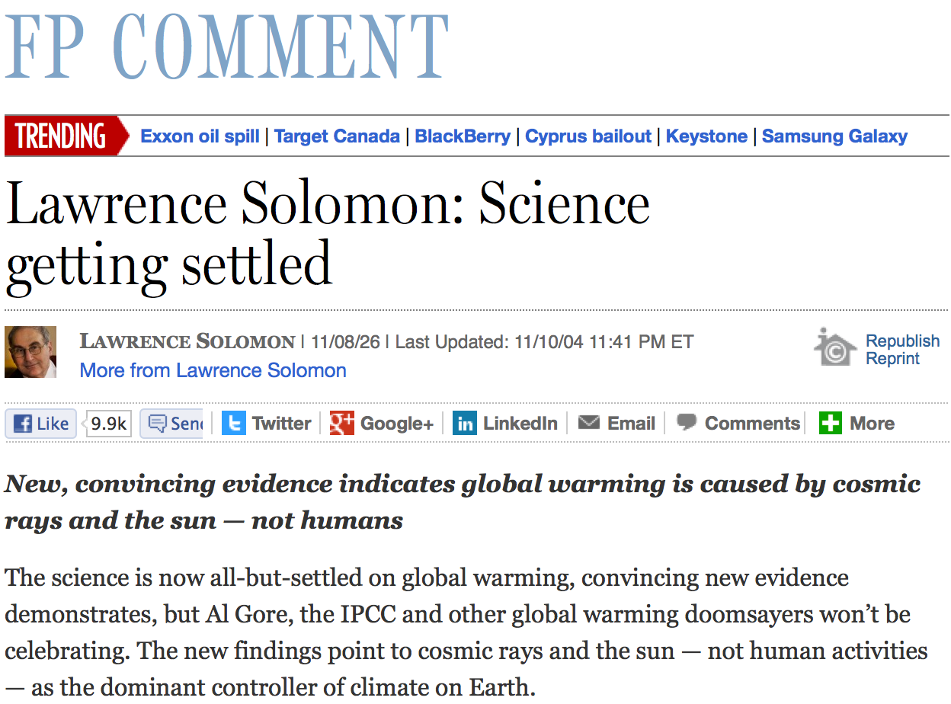
Distractions …
“Climategate” – out-of-context quotes from hacked emails → every independent investigation exonerated the scientists
CERN study
Financial Post Aug 26, 2011

Slide 38
Lawrence Solomon: Science getting settled | FP Comment …opinion.financialpost.com/.../lawrence-solomon-science-now-settled/Aug 26, 2011 – New, convincing evidence indicates global warming is caused by cosmic rays and the sun — not humans. The science is now all-but-settled …
Global Warming Caused by Cosmic Rays and the Sun - Not Humans nexus.2012info.ca › ... › Earth Matters › Climate & Environment 8 posts - 6 authors - Aug 31, 2011 Lawrence Solomon The Financial Post Fri, 26 Aug 2011 22:37 CDT ... The new findings point to cosmic rays and the sun ...
Alarmists Got it Wrong, Humans Not Responsible for Climate …www.ibtimes.com/alarmists-got-it-wrong-humans-not-responsible-cli...Sep 1, 2011 – ... rays and the Sun, not human activities, responsible for global warming, ... CERN, which created and operates the Large Hadron Collider
Scientists prove Global Warming caused by the sun, not humans ... channel9.msdn.com/.../Scientists-prove-Global-Warming-caused-by-t... 18 posts - 9 authors - Aug 27, 2011 Scientists prove Global Warming caused by the sun, not humans. http://opinion.financialpost.com/2011/08/26/lawrence-solomon-science-now-settled/ ... The
CERN: The Sun Causes Global Warming | EUTimes.net www.eutimes.net › AstronomySep 3, 2011 – Climate realist and author Lawrence Solomon … cosmic rays and the sun — not human ...
Northerntruthseeker: The Global Warming Farce: Science Is Now … northerntruthseeker.blogspot.com/.../global-warming-farce-science-is...Aug 27, 2011 – Lawrence Solomon ... indicates global warming is caused by cosmic rays and the sun — not humans ...
CERN: The Sun Causes Global Warming
forum.prisonplanet.com/index.php?topic=216579.0 12 posts - 7 authors - Sep 5, 2011
New, convincing evidence indicates global warming is caused by cosmic rays and the sun — not humans. The science is now all-but-settled on ...
New, Convincing Evidence Indicates Global Warming is Caused by ...
midnightwatcher.wordpress.com/…New, Convincing Evidence Indicates Global Warming is Caused by Cosmic Rays and the Sun — Not Humans. 08/27/2011 ICA Leave a comment Go to ...
Maviglio Eclipses Global Warming Logic | CalWatchDog
www.calwatchdog.com/2011/.../maviglio-shuns-global-warming-logi...Aug 30, 2011 – New, convincing evidence indicates global warming is caused by cosmic rays and the sun — not humans. The science is now all-but-settled on ...
Study: Global Warming is Caused by the Sun, Not Humans ...
fosterfriess.com/.../study-global-warming-is-caused-by-the-sun-not-h...Aug 30, 2011 – Study: Global Warming is Caused by the Sun, Not Humans ... Writing in Canada's Financial Post, Lawrence Solomon, executive director of a ... “[C]osmic rays promote the formation of molecules that in Earth's atmosphere can ...

Slide 39

A view from 230 miles high

Slide 40
Climate of Doubt
Doubt is also being manufactured and distributed by well-funded organizations that used to make their living obfuscating that cigarettes cause cancer
Consider that cigarettes were only accepted to cause cancer after a whistleblower released internal industry documents – its not clear that science alone would have proved the causal link
  They still cause 1 in 5 deaths, 30% of cancers, 87% of lung cancers
  1 in 5 people smoke cigarettes
    Billions are addicted to oil
http://www.pbs.org/wgbh/pages/frontline/climate-of-doubt/

Slide 41
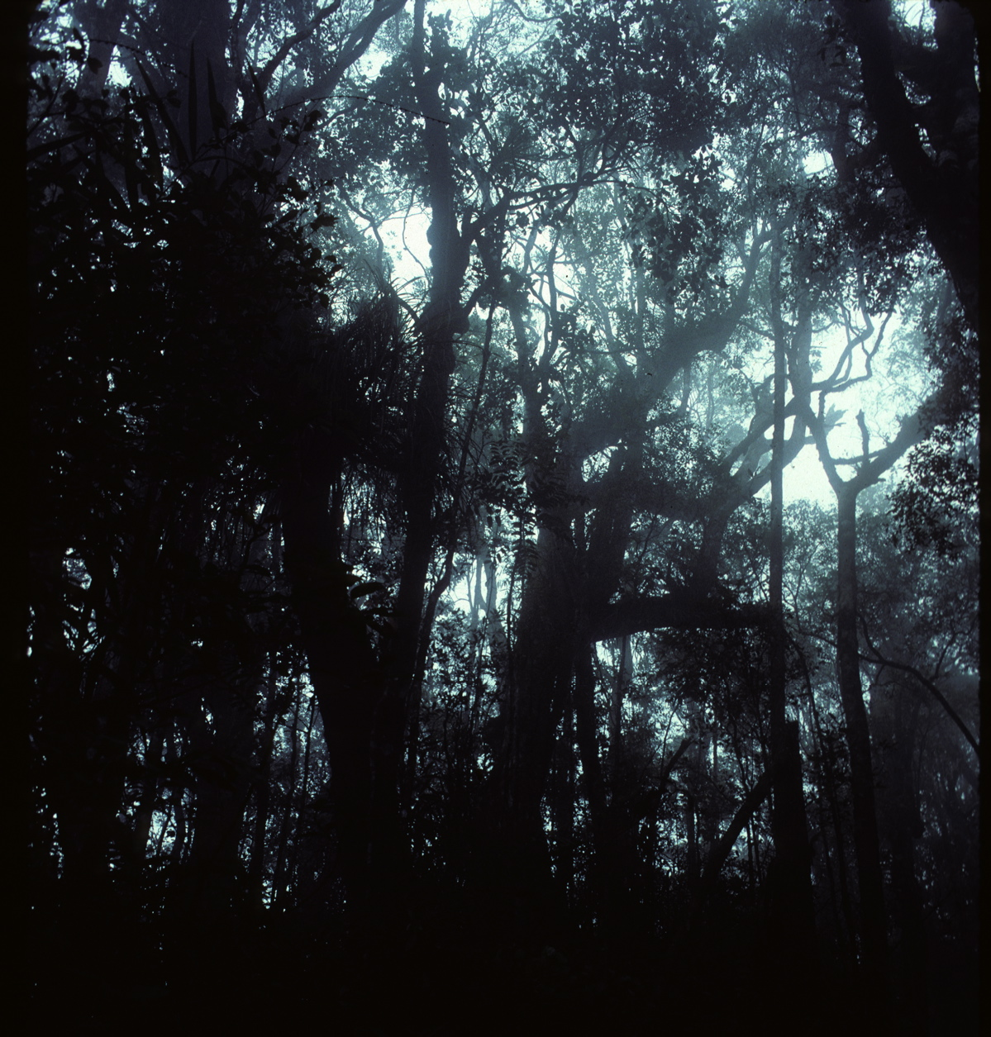

Slide 42
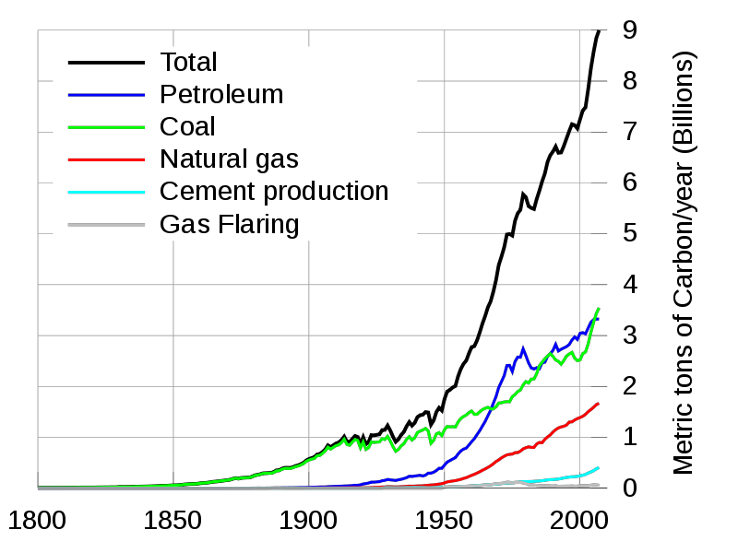
Exponential Growth
Human population, energy consumption, atmospheric CO₂, and many other natural phenomena increase in proportion to their size – this is called exponential growth

Slide 43
Exponential Growth
Imagine a strain of bacteria with a 1 minute division time. The number of bacteria grows exponentially with a doubling time of 1 minute (mathematically equivalent to our exponentially growing consumption of oil, with a ~10 year doubling time).
One bacterium is put in a bottle at 11:00 a.m. and it is observed that the bottle is full of bacteria at 12:00 noon.
Questions:
When was the bottle half-full?
At what time might a hypothetically intelligent bacterium realize that they were running out of space?
How long can the bacterial growth continue if the total space is quadrupled (e.g., 3 more empty bottles are found)?
Adapted from Al Bartlett, “Forgotten Fundamentals of the Energy Crisis”
http://www.youtube.com/view_play_list?p=6A1FD147A45EF50D

Slide 44
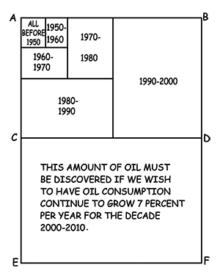
Visualizing exponential growth
This is why energy companies are risking drilling in the Arctic and 2 miles below the ocean – and fracking and developing tar sands – to keep growing a little longer

Slide 45
Green energy
Fossil fuels are billions of years of fossil solar energy
They benefit from trillions of dollars of amortized infrastructure (physical, technological, political, …)
Best-case analysis
As long as their long-term (ecological) costs are subsidized or ignored, green energy will have trouble competing against fossil fuels
  Exxon would probably be making gasoline from algae, vs. tar sands if they had to pay long-term environmental costs

Slide 46
$1 Trillion for solar energy
My CSUCI students were given this problem: you have $1T to invest in photovoltaics. How much energy and CO₂ reduction will this buy, and how fast can it be implemented?
Extrapolating present trends of production capacity and costs: In 6 years we’d install 1 TW of capacity, producing ~8% of our energy (in 2008) and reducing CO₂ by 1 gigaton (20%) each year
  The energy and CO₂ benefits would repeat for >20 years with minimal maintenance costs

Slide 47
Prognosis
Our culture and economics, based on growth and short-term values, is crashing into the reality of physical and ecological limits
Modern agriculture = the use of land to convert oil into food, will revert to less productive organic farming – which is also the only proven method to sequester CO₂
Climate change will continue, increasing wealth and power disparities, and causing unpredictable events

Slide 48
Prognosis
Many conservatives recognize these forces and are trying to fortify the existing social and technological base
Many progressives recognize these forces and are trying to change the existing social and technological base
These world views are diametrically opposite, so this will be an ugly ideological fight
  Each considers the other sociopathic terrorists trying to destroy the ecology or the culture

Slide 49
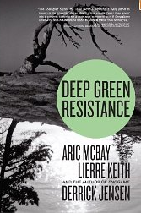
“Decisive Ecological Warfare”
  “The dominant culture – civilization – is killing the planet, and it is long past time for those of us who care about life on earth to begin taking the actions necessary to stop this culture from destroying every living being.”
  “There is no real left in US politics, no party that offers any critique of capitalism. This terribly constrains the range of political solutions we might seek.”

Slide 50
Actions to consider
Join 350.org, the Sierra Club, and other groups advocating for global ecological justice
Voice opposition to the Keystone XL pipeline
Pressure and divest in CO₂ polluting companies
Lobby to put a price on environment costs
Contemplate future value and future costs of your actions and purchases
  Our lives are short, and we have 1 shot … use it well!
Prepare for uncertainties – and the opportunities and risks they may offer
  Your choices & impacts tomorrow maybe totally different

Slide 51
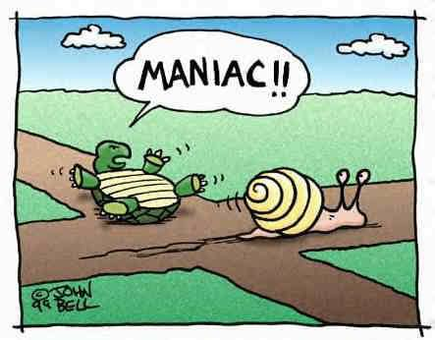
Keep a positive attitude …
Apologies to
Look at me –
I’m flying!!

Slide 52
Discover your psychology
What were your favorite and least favorite parts of this presentation?
What different ideas did the photos, text, graphs, my words and demeanor, each convey to you?
What might you have missed or misunderstood because of the way it was presented?
How might you become a more versatile and critical thinker?
    Exercise weaker cognitive modalities
The complex nature and scale of global warming makes it nearly impossible to feel without quantitative analysis
    Just because we can’t feel CO₂ doesn’t mean its not as threatening as terrorism
Notes:
This presentation has included information in a few different modalities.

Slide 53
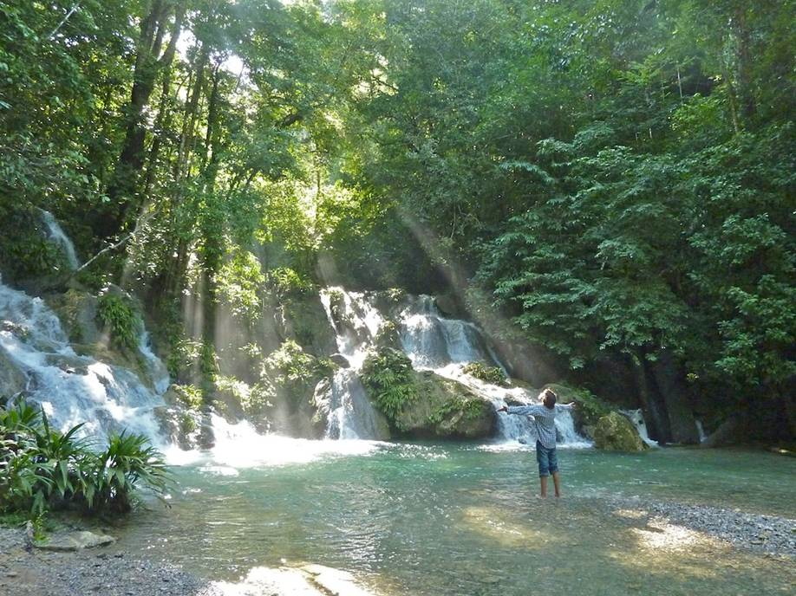
Thank you!!
Questions!!

Slide 54
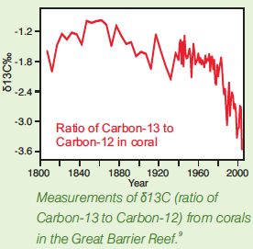
Fossil fuel signatures
Fossil fuels are enriched in Carbon-12. Corals are also becoming enriched in

Slide 55
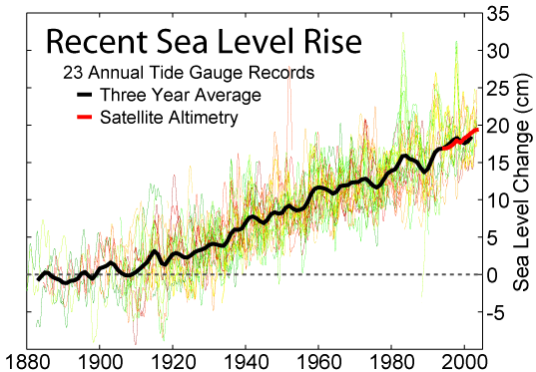
Sea level thermometer
Sea level rises as land ice melts and warmer ocean water expands
The vast continuity of the oceans computes a spatial average for us

Slide 56
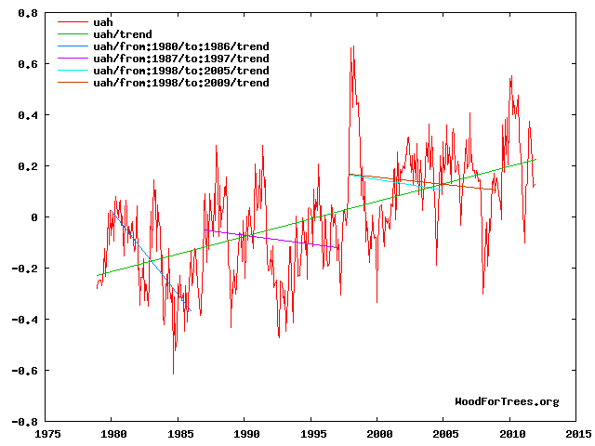
There is no rational doubt about global warming
But one can still play tricks with statistics
Misunderstand complex interactions (e.g., increased Antarctic sea ice)
Embellish confusion at the frontiers
Etc.

Slide 57
Prior notions profoundly affect how we perceive new information
Those with a tendency to reject environmentalism use uncertainties and debates at the margins of scientific research to support …
Costs of mitigation – doing nothing leads to a “healthy” secondary forest in many places, at no cost, and if you’re not a biologist or farmer or hunter-gather, etc., you may hardly know the difference …
Risks of mitigation
Doing nothing has consequences too

Slide 58
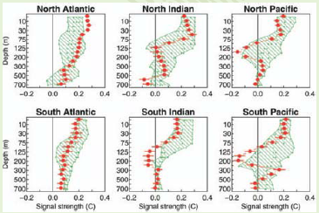
The oceans are 3-d
We’re mostly aware of sea surface temperature
These plots are measurements and computer models of temperature profiles vs. depth

Slide 59
Peak Oil
Eventually we will run out of oil
  That should slow GHGs
Tar sands, methane leaks from fracking and hydrate mining will accelerate GHGs
  We’re using more energy (CO₂) to get energy
  2011 CO₂ emissions were the highest recorded
To keep the price of oil down and perpetuate our (unsustainable) economy, expect greater risk taking, and more accidents (e.g., BP’s Deepwater Horizon; Shell’s Arctic fiasco; Exxon’s Arkansas pipline rupture, etc. etc.

Slide 60
Tobacco and cancer
Proving causality in complex systems is difficult, if not impossible
  The tobacco industry funded a propaganda campaign to generate doubt
  That cigarettes cause cancer was only accepted (and warnings mandated by law) when an industry whistleblower released internal documents
The science (without the whistleblower) was not powerful enough to eliminate doubt about cigarettes causing cancer
Can we expect our scientific enterprise will prove anthropogenic climate change – which would devastatingly devalue the most powerful corporations (people)?
  We’re addicted to oil …

Slide 61
Current facts about smoking
Tobacco causes 440,000 early deaths (1 in 5) in USA
Tobacco causes 30% of cancer deaths, 87% of lung cancer deaths
About 1 in 5 adults smoke
And that’s a lot more up-close and personal than global warming …

Slide 62
“Decisive Ecological Warfare”
“At this point there are no good short-term outcomes for global human society.” “Human society – because of civilization – has painted itself into a corner.”
“There’s no physical reason we couldn’t get together and act like adults and fix these problems… but the material systems of power make this impossible… We aren’t going to save the planet – or our own species – without a fight.” (pp. 425-6)
Notes:
Read p. 425.

